Slide 1




CODE EMIRATES
HACKTOBERFEST 1.0

Slide 2






Problem statement
A Mobile app or Website that gives information of various Problems like Water, Electricity, Sewer from around the Community, Open Source Data etc. And Display them a Map. Looking Forward to Seek other Features also which can be helpful for the Society.
-Community awareness
-Efficient problem resolution
-Data driven decision making
-Citizen empowerment and involvement
-Sustainable development planning
PROVIDE STATISTICS OR DATA TO SUPPORT YOUR ARGUMENT.

Slide 3




Solution
-Taking surveys
User friendly interface
Interactive map integration
Real time updates
Data analysis and visualization
GIS

Slide 4


Key Features and Functionality
USER-FRIENDLY INTERFACE WITH HTML AND CSS.
USE OF GIS.
CUSTOMIZABLE SETTINGS TO TAILOR USER EXPERIENCE WITH USE OF VARIOUS VISUALISATION TOOLS

Slide 5


Social impact
TRANSPERANCY AND ACCOUNTABLITY.
SUSTAINABLE DEVELOPMENT.
CIVIC MANAGEMENT.

Slide 6

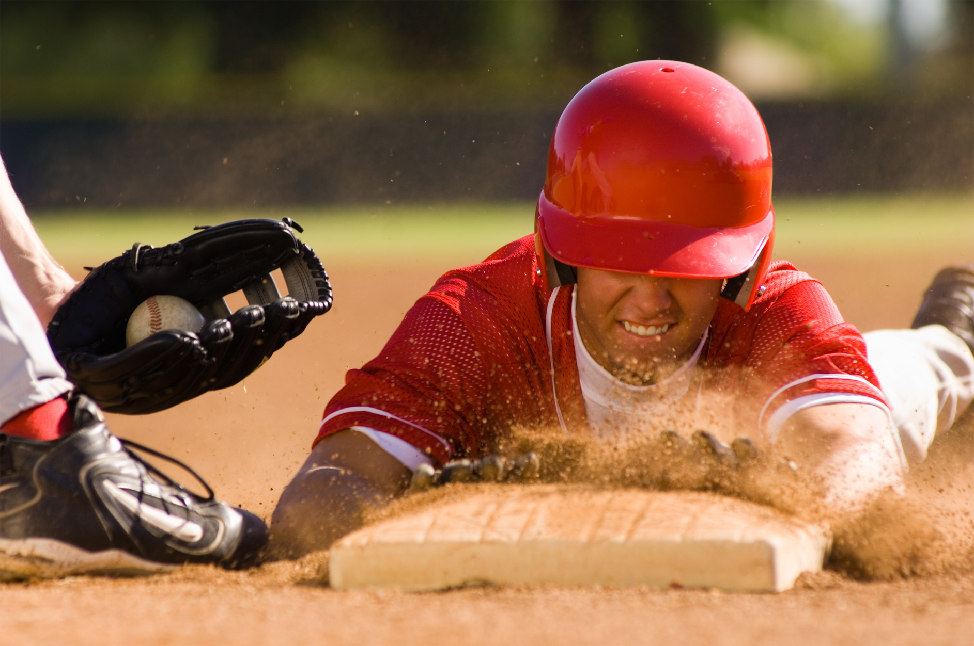
Revenue Model
Freemium Model: Offer basic functionalities of the platform for free, and charge a subscription fee for access to premium features such as advanced data analytics, exclusive educational content, and personalized notifications.
Advertisement Model: Generate revenue through targeted advertisements from local service providers, businesses, and organizations relevant to the community's needs and interests. Consider offering different advertising packages based on the reach and prominence of the advertisements on the platform.
Service Provider Listing Fees: Charge local service providers a fee to be listed in the platform's directory, offering premium listings with enhanced visibility and promotional features. Consider offering additional marketing services to service providers as part of the package.

Slide 7



Technologies Used
OUR TEAM UTILIZED A VARIETY OF TECHNOLOGIES INCLUDING PROGRAMMING LANGUAGES LIKE HTML CSS AND JS, AS WELL AS TOOLS LIKE GITHUB OR GITLAB.

Slide 8

The Team
PRATIK JHA
(LEADER)
SRIKAR
(MEMBER)

Slide 9


Thank You
HACKTOBER FEST

